Slide 1




UE20CS390A – CAPSTONE PROJECT APPROVAL
Voice Interface For PESU Using AI
Project ID: PW23_PB_01
Project Guide: Prof. Priya Badrinath
Project Team: 805_806_826_844
Team Members
Nitin Gaurav (PES1UG21826)
Arya Girigoudar (PES1UG21806)
Vishnu Patgar (PES1UG21844)
Ankit Borker (PES1UG21805)

Slide 2

Introduction
Voice control is a major growing feature that is changing the way people live
(from smart homes to smart tv to smart phone we have voice control)
Problems With Website and App Include
Have to Login After timeout or After Session Ends
Interface Lags
Experience Downtime
Too much process to go through to get the desired result
Old school(voice assistants are cooler)

Slide 3
Applications
Login using account credentials
Fetch Courses, ISA Results ,Attendance ,Notifications etc.
Gives All kind info of particular student.
Apart From Academics It can also be used as personal Voice Assistant

Slide 4
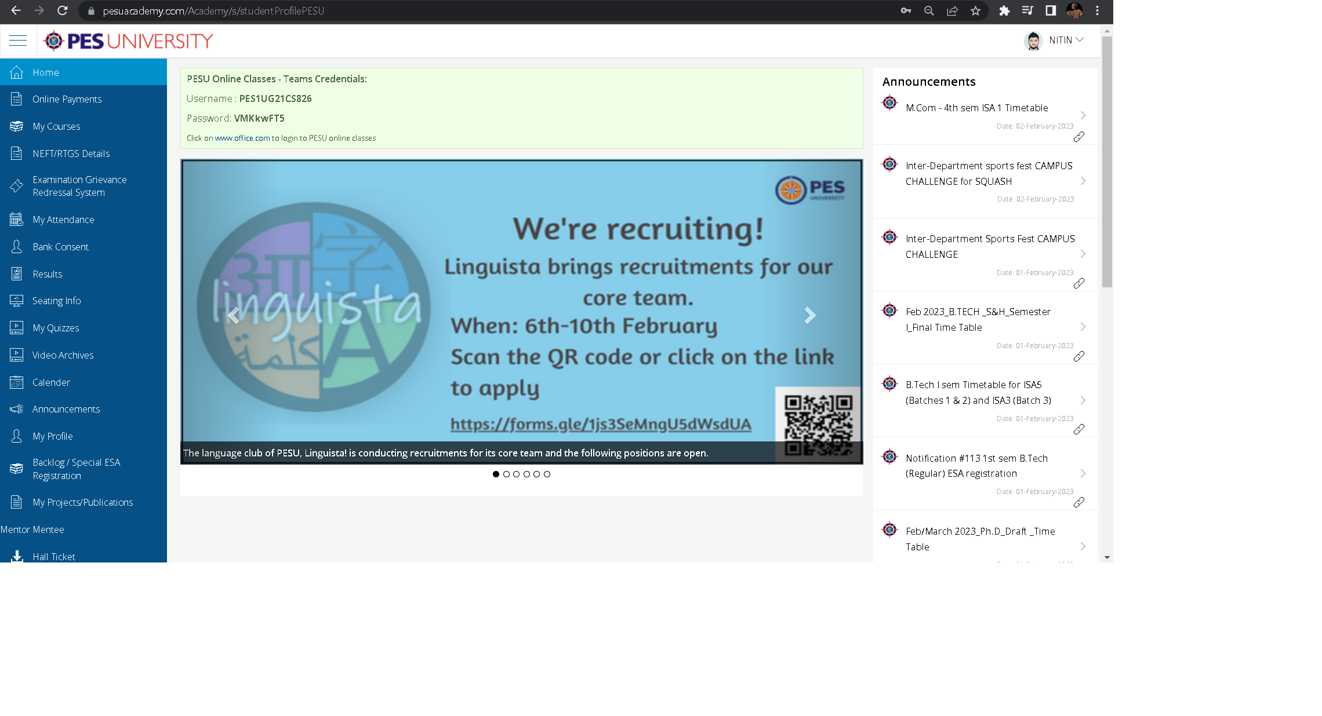




**
Hey pesu! Show me my courses

Slide 5
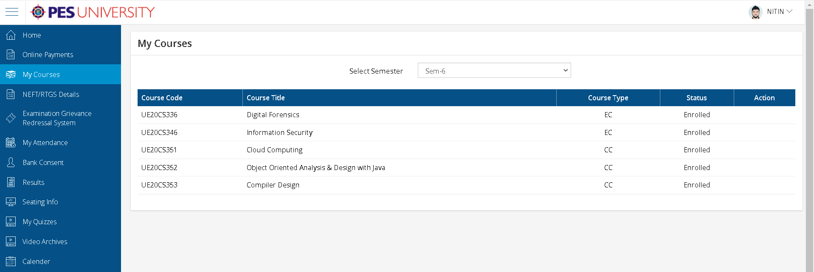

Result we will get!!!
Your courses are
wow

Slide 6
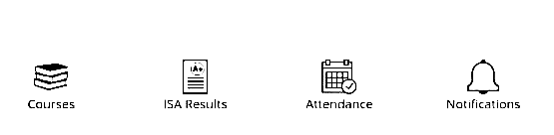


KEY FEATURES

Slide 7

Scope
Easier access to PESU resources
Get The Latest Information about academics
Detect and respond to Owner Only
Tap talk and get wherever you wish in PESU academy
Personal voice assistant for students

Slide 8

Capstone-I deliverables
Requirements needed:
Python programming language
Speech to text API module
Speech Learning algorithm using NLP
Detailed Implementation Plan :
Database Design :
Modules Used :

Slide 9

Capstone II deliverables
End Product will be made
Documentations of everything will be done i.e. srs and report making will be done
Research Papers will be made and published
Database Documentation will also be done
Monitoring and Control of Documents will be as having CIA triad in mind

Slide 10
Challenges we are going to face :
Biggest Threat to our project is Maintaining Student Data And their Privacy
The algorithm should work properly while its phase for learning of one’s voice
Proper authentication is tough to implement as it may hamper the key features
Making The assistant understand between similar sounding words
The vastness of project and promise of deliverables itself
PESU Should allow us to Scrap www.pesuacademy.com/Academy/ Website for it to be implemented for pesu academy portal

Slide 11

Some examples how things will be after we implement this to pesu academy
Okay! Showing attendance
Hey Pesu! Show me my attendance

Slide 12
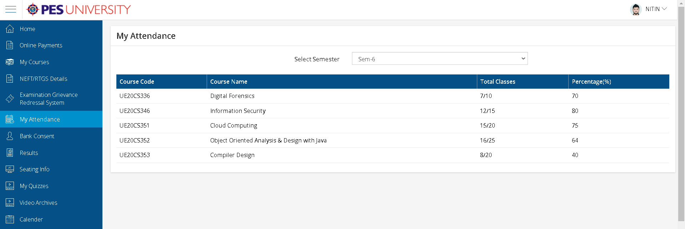

Your attendance is !!
Ohh! Thanks to this assistant now I know how much attendance I have

Slide 13

Some examples how things will be after we implement this to pesu academy
Okay! Showing result of 4th sem
Hey Pesu! Show me my final result of 4th sem

Slide 14
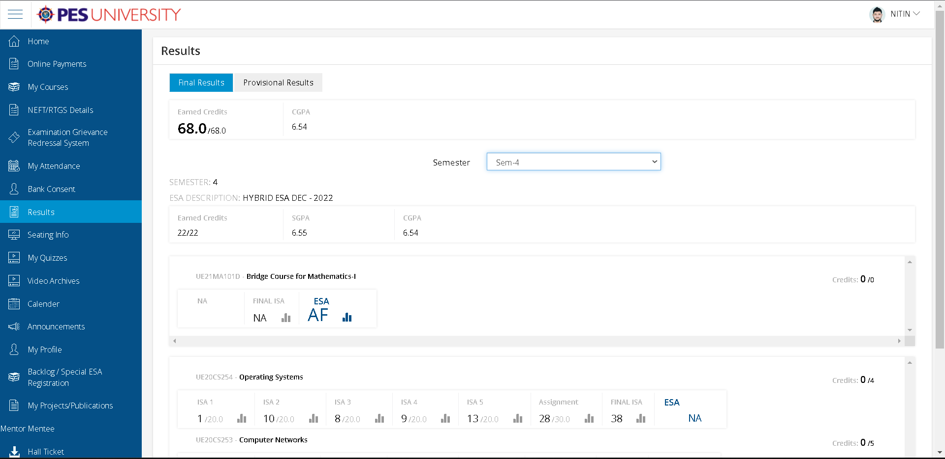


Showing your 4th
sem. result!!
Ohh no! I must study harder.

Slide 15
References
Privacy Issues In Voice Assistant Ecosystems
My Voiceprint Is My Authenticator: A Two-layer Authentication Approach Using Voiceprint for Voice Assistants
Investigation and Development of the Intelligent Voice Assistant for the Internet of Things Using Machine Learning
Short Research on Voice Control System Based on Artificial Intelligence Assistant
Personal Voice Assistant Security and Privacy
Exploring the Determinants of Users’ Continuance Usage Intention of Smart Voice Assistant

Slide 16

That’s the end of our Presentation
Thank You

